Slide 1
WEAR WEather Attire Recommender
Presented by: -Karim Hamawi
-Rabih Ayoub
-Ghassan Awwad
Supervised by: Dr. Maria Abi Saad

Slide 2
Table of contents
01
02
03
Introduction
System Architecture
The Database
05
06
04
Backend Implementation
Hardware Implementation
Frontend Implementation
07
08
09
Demo
Conclusion
References
2

Slide 3
01
Introduction
3

Slide 4
Time and Decision Fatigue
Men spend approx. 4 months of their lives deciding what to wear
Women spend about 6 months on the same task
Valuable time that could be utilized more effectively
Decision fatigue from daily outfit choices
Solution: WEAR (WEather Attire Recommender) system
4

Slide 5
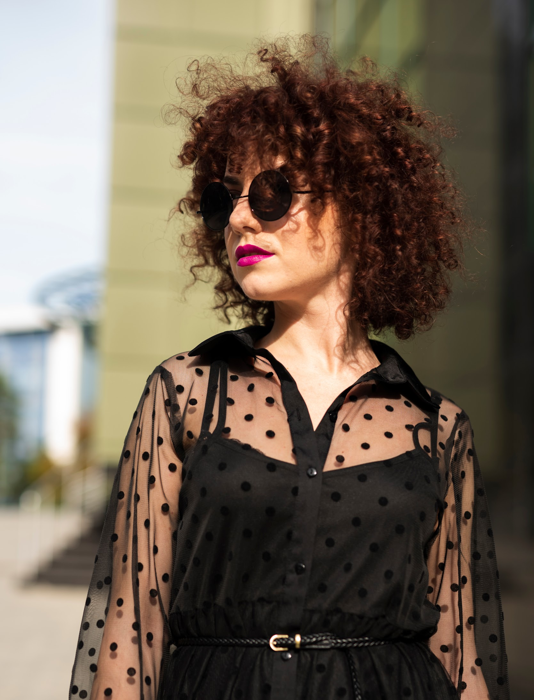
WEAR
Overcomes the limitations of the existing solutions
Takes into account the temperature, weather conditions, and humidity
Accounts for activity/event
The suggested outfit consists of matching clothes
Can function offline thanks to its hardware
Can be used by visually impaired people
5

Slide 6
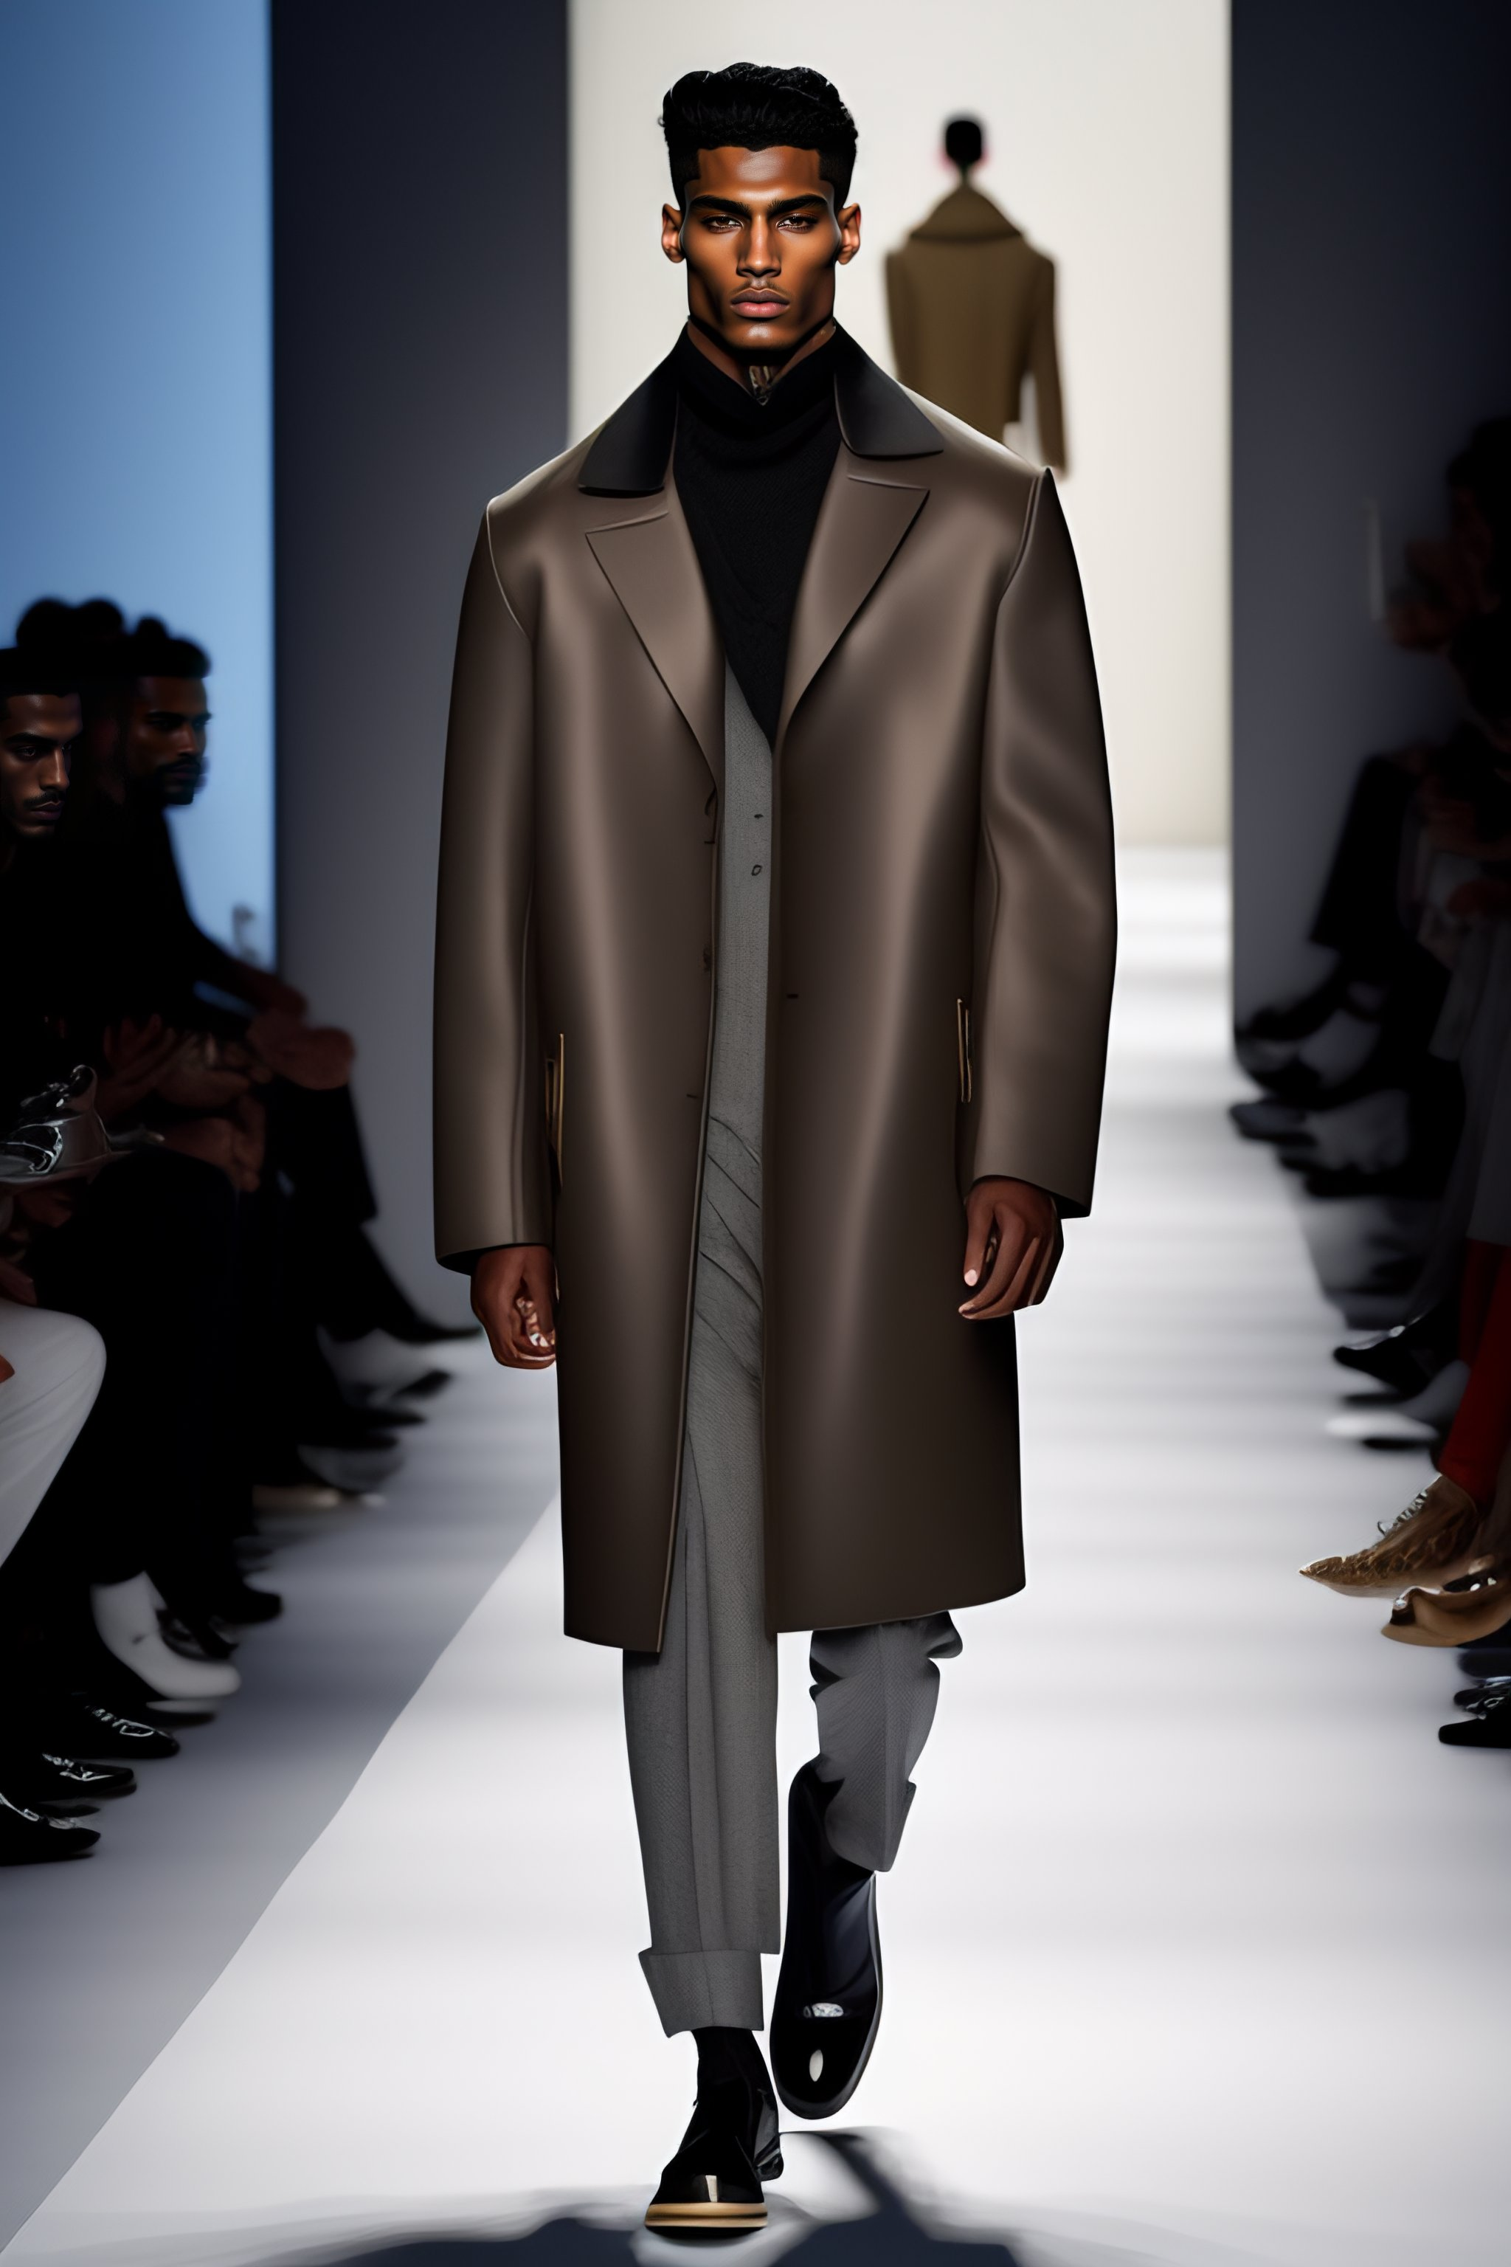
System Architecture
02
6

Slide 7
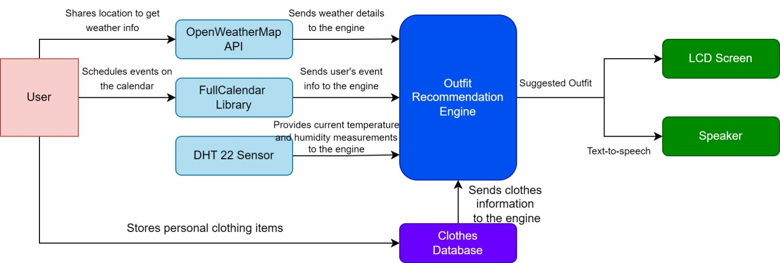
System Architecture
7

Slide 8
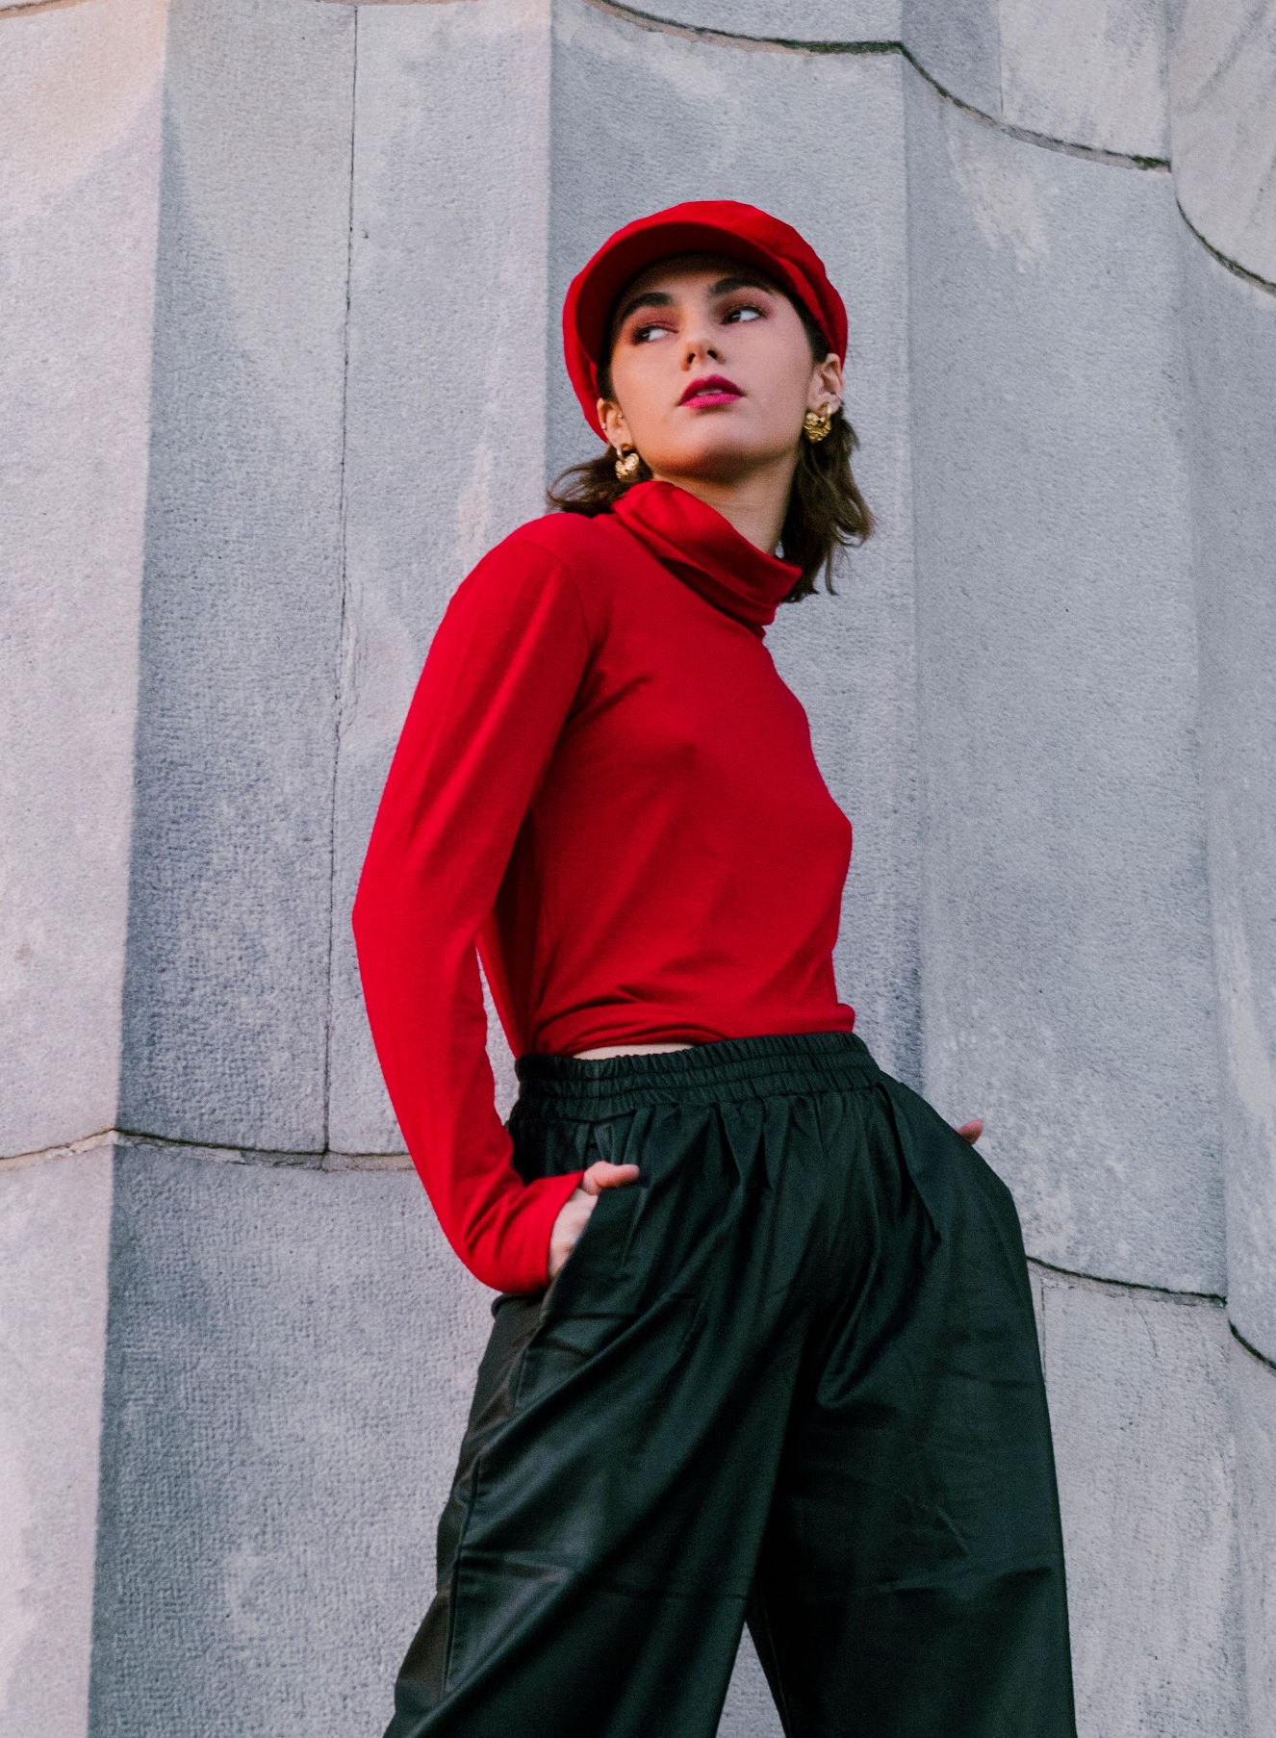
03
The Database
8

Slide 9
The Database
The following attributes will be used for storing the clothes:
•Type: Shirt, Trousers, Dress, Jacket, and Skirt
•Color: Yellow, Red, Green, Blue, Black, White, Purple, and Orange
•Fabric: Silk, Polyester, Wool, and Cotton
•Season suitability: Winter, Fall, Summer, and Spring
•Style: formal, athletic, vintage, and casual
•Condition: New, Used, and Worn
9

Slide 10
04
Backend Implementation
10

Slide 11
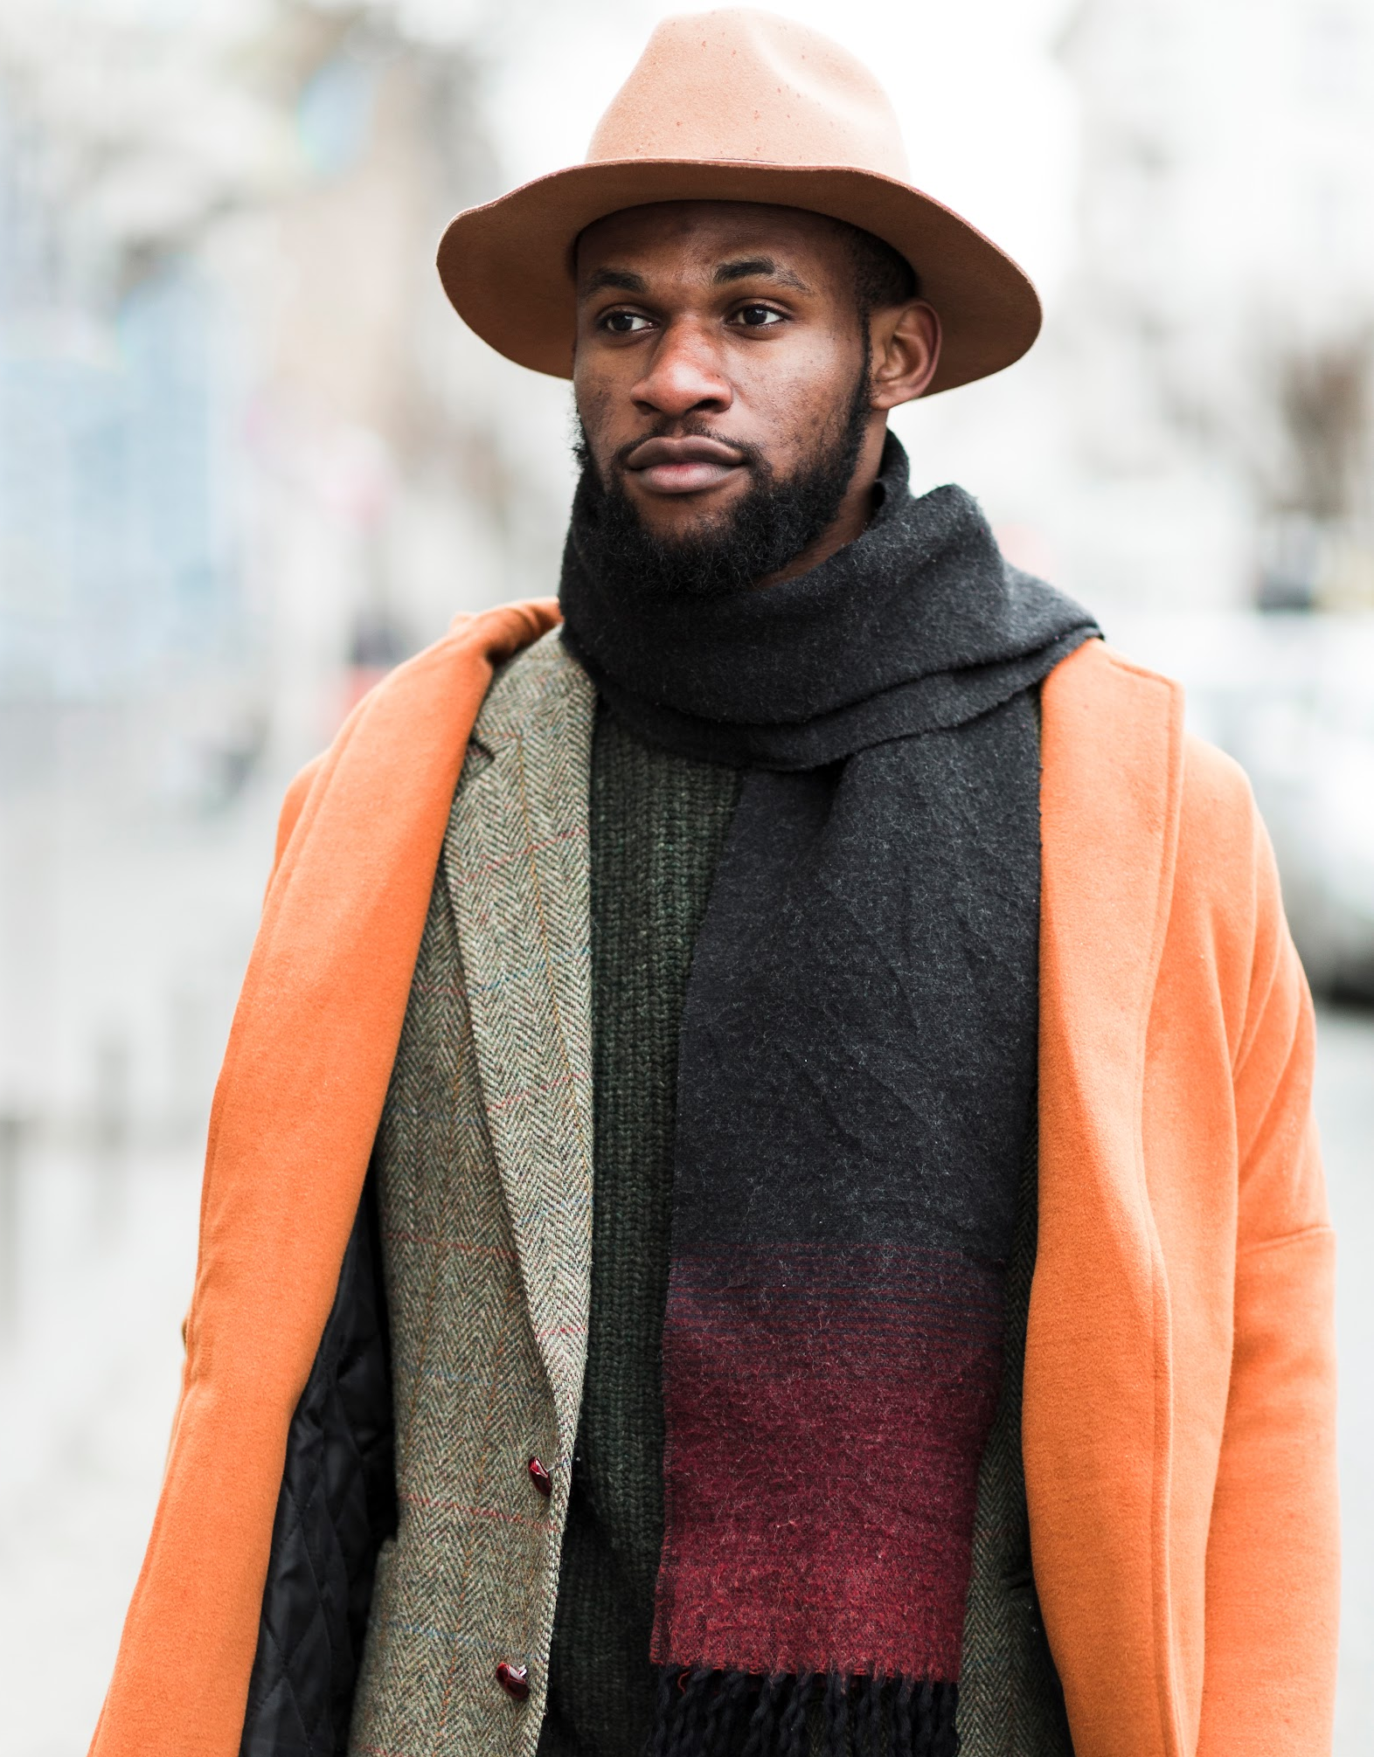
Training the Data
A 1000-row dataset was generated using AI
In addition to the attributes Type, Color, Fabric, Season Suit., Style, and Condition, the following were added:
Temp. (°C): The temperature at the time of usage
Weather Cond: Sunny, Rainy, Snowy, Windy, Cloudy
Humidity (%): 0-30% (low), 31-50% (moderate), 51-100% (high)
Type of event: Casual Outing, Formal Event, Sports Activity
11

Slide 12
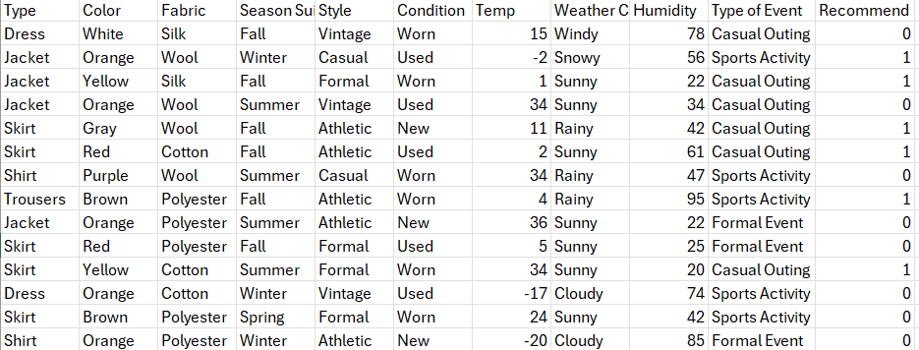
Recommendations
Recommended column is filled based on whether given cloth is suitable for respective weather conditions and activity:
12

Slide 13

OpenWeather API
Choice of OpenWeatherMap API:
Easy-to-use architecture for rapid integration.
Provides extensive weather data: historical, forecasts, and current conditions.
Global coverage ensures accurate weather data for Lebanese regions and beyond.
How the API Works:
User Location Data: The system uses user-provided location data.
API Call: Makes HTTP/HTTPS requests to OpenWeatherMap endpoints.
Response: Receives a JSON payload with weather information.
Data Utilization: Extracts essential weather details (temperature, humidity, conditions) for clothing recommendations.
13

Slide 14

OpenAI API
Purpose:
Integrates with the OpenAI API for advanced natural language processing.
Classifies and interprets event types from textual descriptions, as well as the weather type
Helps tailor outfit suggestions based on the nature of the event (e.g., formal, casual).
How the API Works:
Event Description: Receives textual descriptions of events.
API Call: Sends event descriptions to the API.
Response: Receives a classification (e.g., Sports Activity, Formal Event, Casual Outing).
Integration: Uses the classification to influence outfit suggestions.
14

Slide 15
Machine Learning Models
K-Nearest Neighbors (KNN):
Configuration: 15 neighbors
Distance Metric: Manhattan distance
Weighting: Points weighted by distance
Purpose: Utilizes the training set to predict the appropriate clothing by considering the nearest data points.
Support Vector Machine (SVM):
Hyperparameters:
Regularization Strength (C): 1
Class Weight: None
Gamma: 0.1
Kernel: Polynomial
Purpose: Trains a classifier to find the optimal hyperplane for separating clothing categories based on weather conditions.
Naive Bayes
Type: Gaussian Naive Bayes
Variable Smoothing:1e-9
Purpose: Applies probability theory to predict clothing choices by assuming feature independence.
15

Slide 16
Results
Model | Accuracy | Parameters
KNN | 77.5%. | Precision: 0.772 Recall: 0.775 F1-Score: 0.772 Accuracy: 0.775
SVM | 82% | Precision: 0.848 Recall: 0.820 F1-Score: 0.825 Accuracy: 0.82
Naïve-Bayes | 65% | Precision: 0.65 Recall: 0.65 F1-Score: 0.65 Accuracy: 0.65
16

Slide 17
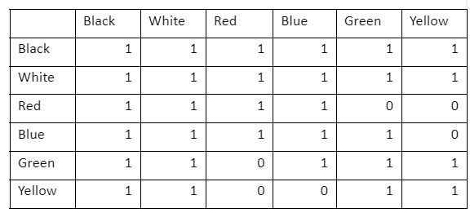
Outfit Recommendation
The following matrix is used to match the colors of different pieces of clothes:
The engine will now recommend an outfit by matching Clothes that are recommended
Receives weather information extracted from the OpenWeather API
Receives the event type and the weather type from the OpenAI API
Uses SVM to choose the suitable pieces of clothing in the current conditions
17

Slide 18
Outfit Scoring
1. Color Matching
2. Season Suitability
3. Style Matching
4. Condition
5. Fabric Suitability
Weight: 1
Increases score if the colors of top and bottom items match.
Weight: 3
Adds points if the item's season suitability matches the current season.
Weight: 5
Increases score if all items in the outfit have the same style, and if style matches event.
Weight: 4
Adds points based on the condition of the items:
New: Full points
Used: Half points
Worn: Quarter points
Weight: 5
Adjusts score based on fabric and current weather conditions:
Polyester/Wool: Extra points in Rain or Snow, and Winter.
Cotton: Points in Sunny, Spring, or Summer.
Silk: Points in Spring, Fall, or partial points in Winter.
18

Slide 19
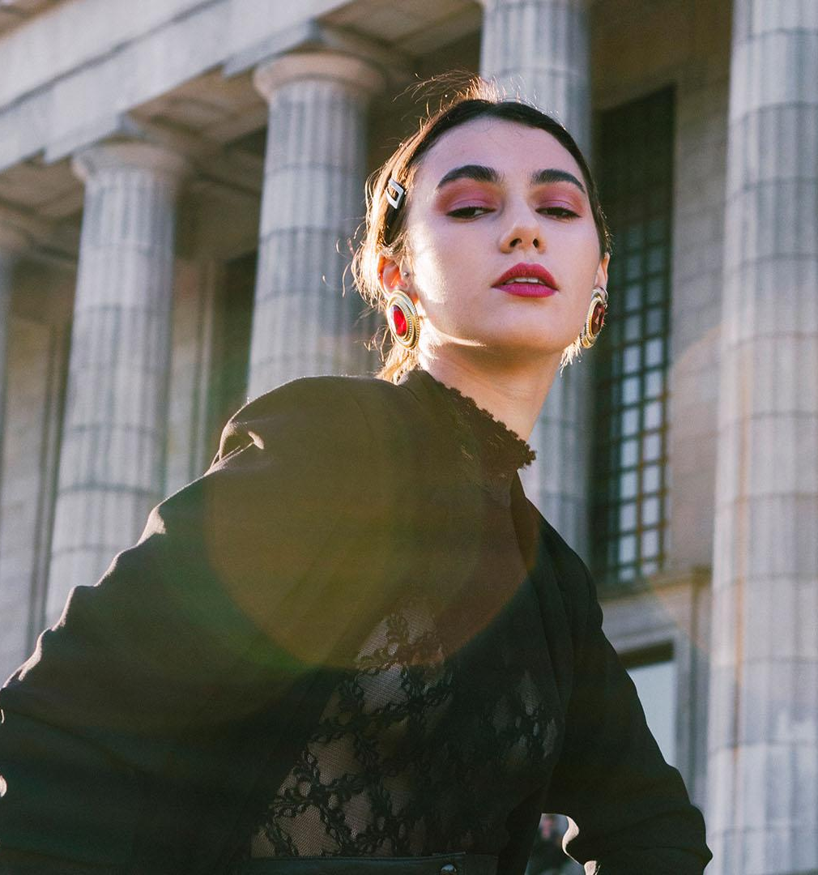
Front end Implementation
05
19

Slide 20
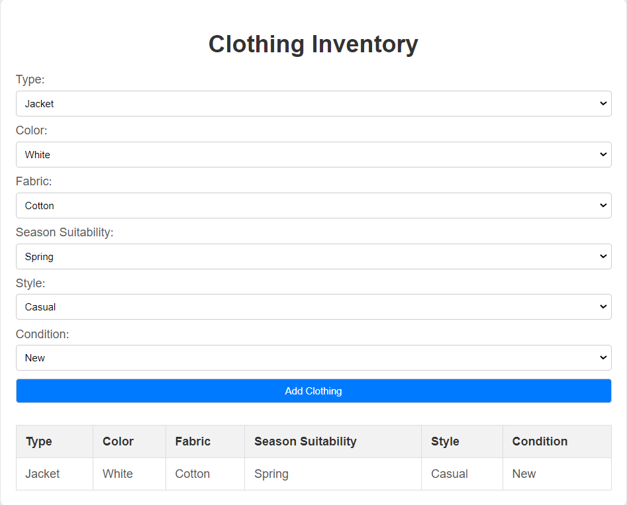
The Clothing Inventory
Designed using HTML, CSS, and JavaScript for a user-friendly interface.
Structured to include elements for clothing inventory management and event scheduling.
Users can input clothing item details through a dedicated form.
Details are displayed in a dynamic table for easy viewing and management.
20

Slide 21
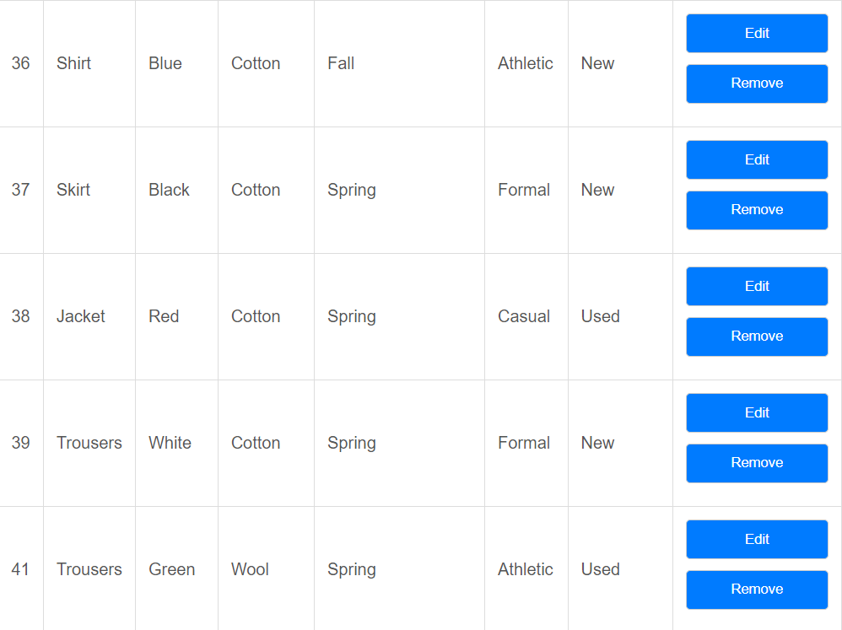
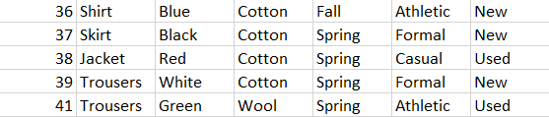
Clothing Inventory Example
21

Slide 22

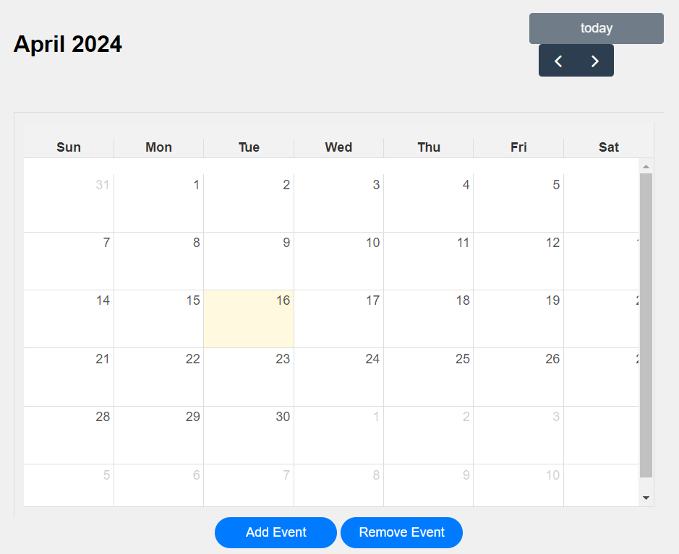
FullCalendar API
JavaScript enhances interactivity and integrates with the FullCalendar library.
Users can add, edit, and delete calendar events with immediate reflection.
JavaScript handles form submissions, data validation, and dynamic updates to the HTML table.
22

Slide 23
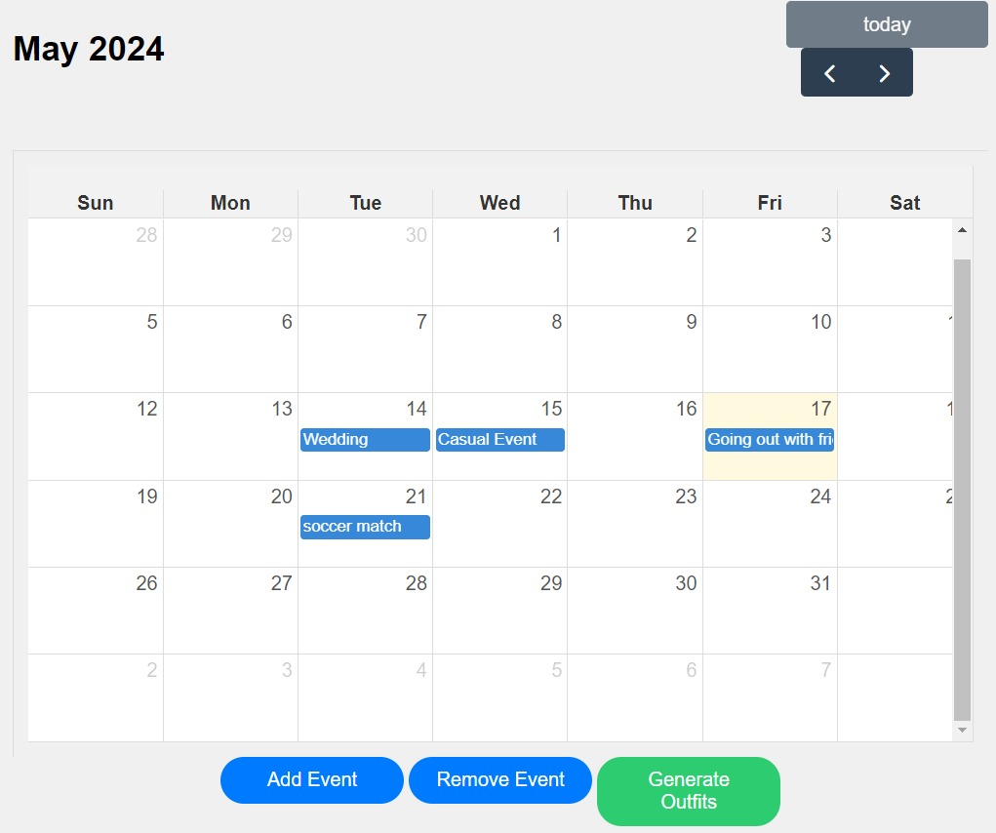
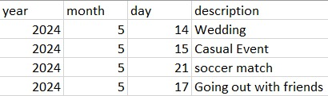
Calendar example
23

Slide 24
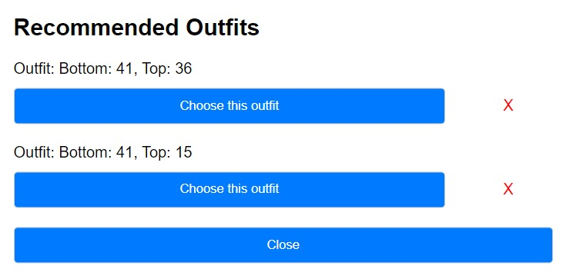
Example Output
24

Slide 25
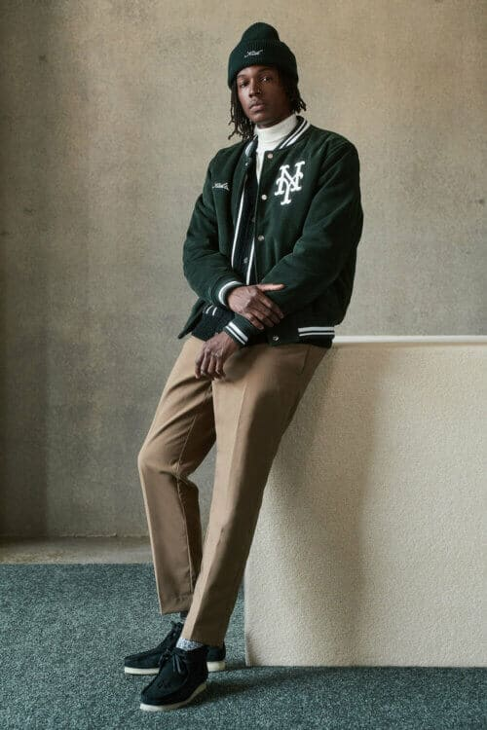
06
Hardware Implementation
25

Slide 26
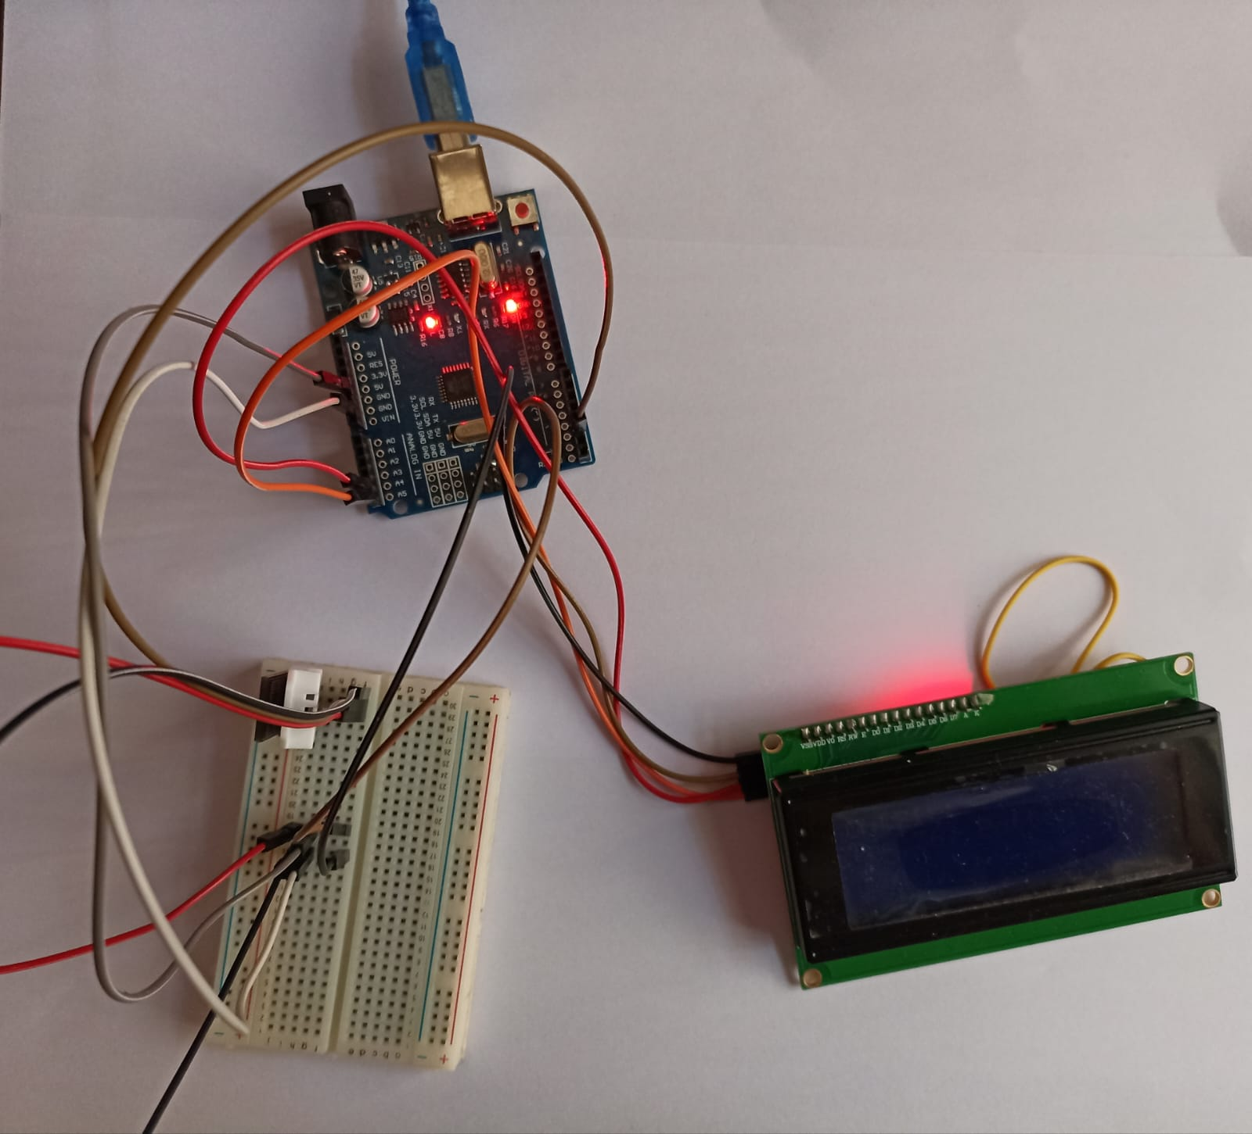
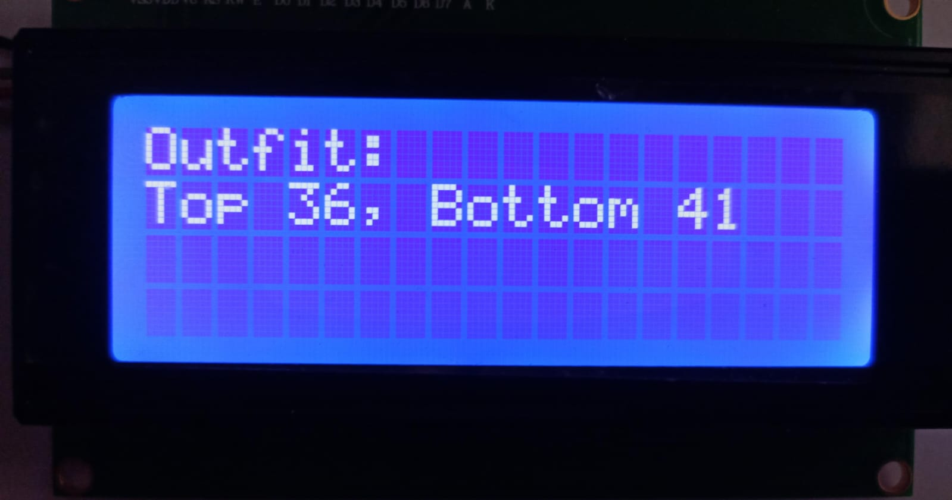
Hardware Connections
LCD Output:
26

Slide 27
Total System Cost
Comprehensive cost overview of components
Details:
Arduino Uno Rev3: $15
DHT22 Sensor: $6
LCD Display Module: $12
Breadboard: $3
Jumper wires: $5
Total Price: $41
27

Slide 28
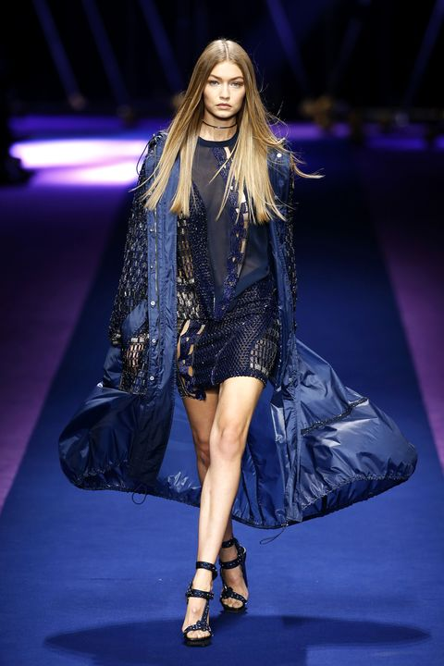
07
Video Demo
28

Slide 29
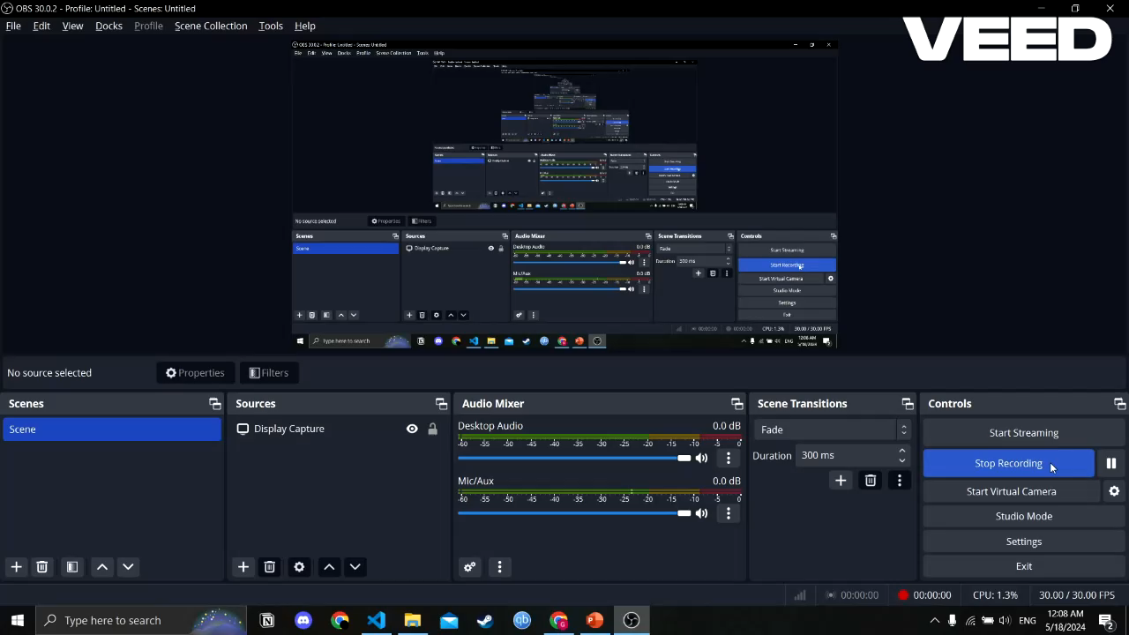
28

Slide 30
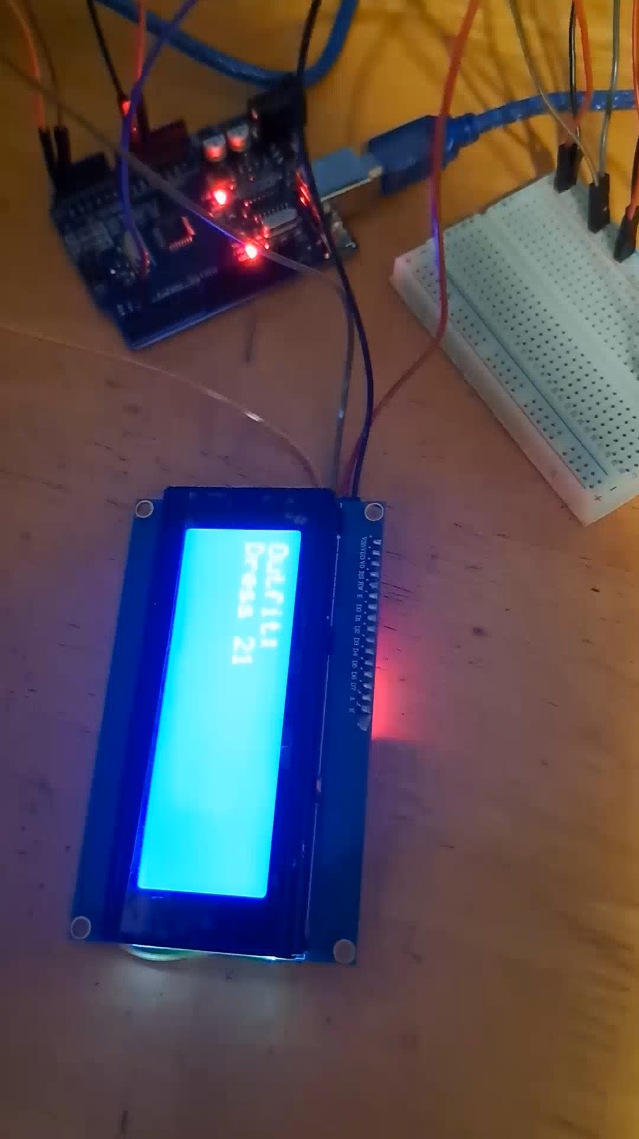
28

Slide 31
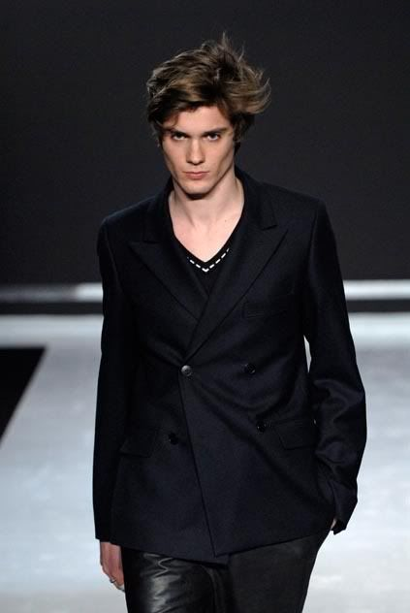
08
Conclusion
29

Slide 32
WEAR System: Final Thoughts
Breakthrough in customized clothing technology
Combines Google Calendar, DHT22 sensors, weather data, and MySQL for outfit suggestions
Customizes based on schedule, preferences, and weather
Limitations: Depends on existing wardrobe, no shoe/accessory advice
Future focus: Expand database, incorporate fashion trend
30

Slide 33
References 1
09
[1] Ai Clothing Detection: Use Cases for fashion and E-commerce. PostIndustria. (n.d.).
https://postindustria.com/ai-clothing-detection-use-cases-for-fashion-and-e-commerce/
[2] Nalwan, A. (2020, January 27). Teaching ai to identify clothes. Medium. https://agustinusnalwan.medium.com/teaching-ai-to-identify-clothes-1feb0a8b3446
[3] Daolio, F. (2018, September 6). Deep learning for fashion attributes. Medium.
https://medium.com/asos-techblog/deep-learning-for-fashion-attributes-763c8c95034c
[4] Nirmal, N. A. (n.d.). The “closet” database: Industry turns to AI algorithms for categorizing
and predicting fashion. ScienceWriters (www.NASW.org).
https://www.nasw.org/article/closet-database-industry-turns-ai-algorithms-categorizingand-predicting-fashion
[5] Team, I. E. (2023, September 19). 10 key benefits of machine learning (with uses and faqs).
10 key benefits of machine learning (with uses and FAQs). https://uk.indeed.com/careeradvice/career-development/benefits-of-machine-learning
[6] Uses and benefits of Machine Learning for Your Enterprise. Matillion. (n.d.).
https://www.matillion.com/blog/the-uses-of-machine-learning-and-the-benefits-for-yourenterprise
[7] Adservio team. (2022, September 16). Machine learning: Types: Benefits. Adservio.
https://www.adservio.fr/post/machine-learning-types-benefits
[8] Cliff, M. (2016, June 5). Women spend six months of their working lives deciding what to
wear - and suffer “Wardrobe rage” over trying to choose the right outfit . Daily Mail
Online. https://www.dailymail.co.uk/femail/article-3626069/Women-spend-SIXMONTHS-working-lives-deciding-wear.html
[9] Arduino Uno REV3. Arduino Official Store. (n.d.). https://store.arduino.cc/products/arduinouno-rev3
[10] Industries, A. (n.d.). Emic 2 text-to-speech module. adafruit industries blog RSS.
https://www.adafruit.com/product/924
31

Slide 34
References 2
09
[11] Low-cost yellow green 4004 40X4 charcter LCD display module. BuyDisplay.com. (n.d.). https://www.buydisplay.com/low-cost-yellow-green-4004-40x4-charcter-lcd-displaymodule
[12] Addicore DHT22 (AM2302) temperature and humidity sensor. Addicore. (n.d.). https://www.addicore.com/products/dht22-temperature-and-humidity-sensor 37
[13] Kalantidis, Y. (2013, April). Getting the look: Clothing recognition and segmentation for automatic ... Getting the Look: Clothing Recognition and Segmentation for Automatic
Product Suggestions in Everyday Photos. https://www.researchgate.net/publication/243973142_Getting_the_Look_Clothing_Recognition_and_Segmentation_for_Automatic_Product_Suggestions_in_Everyday_Photos
[14] Bossard, L., Dantone, M., Leistner, C., Wengert, C., Quack, T., & Gool, L. V. (1970, January 1). Apparel classification with style. SpringerLink. https://link.springer.com/chapter/10.1007/978-3-642-37447-0_25
[15] Liu, S. (2012, October). (PDF) hi, Magic Closet, tell me what to wear! - researchgate. Hi, magic closet, tell me what to wear! https://www.researchgate.net/publication/233988887_Hi_magic_closet_tell_me_what_to_wear
[16] Deep Learning In Fashion (Part 3): Clothing matching tutorial. Indico Data. (2021, October
22). https://indicodata.ai/blog/fashion-matching-tutorial/
[17] Liu, Y. (2017, July). Weather-to-garment: Weather-oriented clothing recommendation - researchgate. Weather-to-garment: Weather-oriented clothing recommendation.
https://www.researchgate.net/publication/319569282_Weather-to-garment_Weatheroriented_clothing_recommendation
[18] Weather fit - IOS weather app that tells you what to wear. Weather Fit - iOS weather app that tells you what to wear. (n.d.). https://weatherfit.com/
[19] Acloset. (n.d.). https://www.acloset.app/
[20] Mixdress-combine clothes app. MixDress - clothes matching app. (n.d.). https://combineclothes.com/
[21] Outfit organizer App. Pureple. (n.d.). https://pureple.com/
32

Slide 35
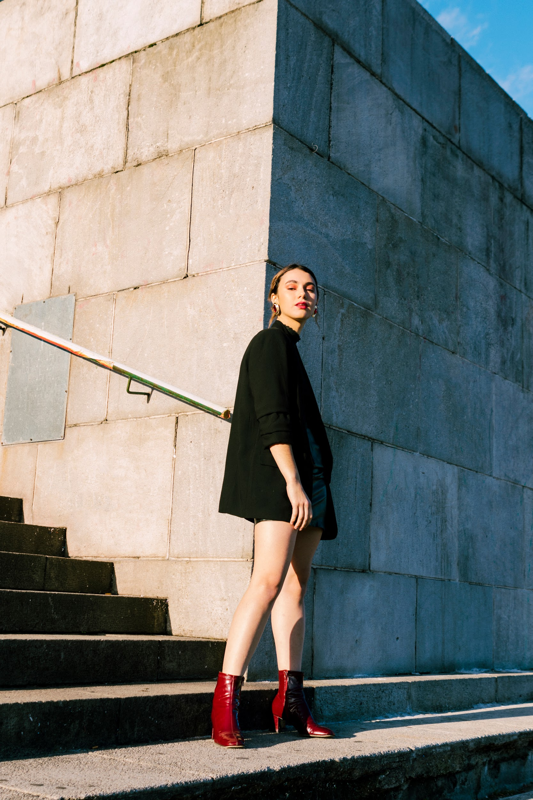
Thank You
33

